Slide 1

IS-201 - Database Chapter 1 – Introduction
Part(2) of (2) Database Engine
DAW MAY THU KYAW
LECTURER
Faculty of Information Science

Slide 2
Outlines
Database Engine
Database Architecture
Database Users and Administrators
History of Database Systems

Slide 3
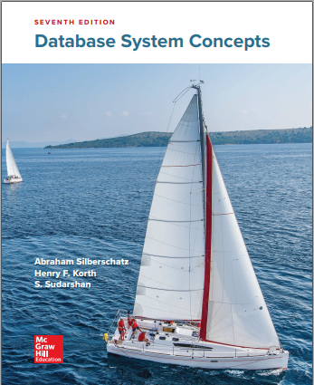
Resources
Textbook
Database System Concepts Seventh Edition, by Abraham Silberschatz Henry F. Korth and S. Sudarshan, 2020.
Content Creator:
Daw May Thu Kyaw, Lecturer, University of Computer Studies, Yangon

Slide 4
Database Engine
A database system is partitioned into modules that deal with each of the responsibilities of the overall system.
The functional components of a database system can be divided into
The storage manager,
The query processor component,
The transaction management component.

Slide 5
Storage Manager
A program module that provides the interface between the low-level data stored in the database and the application programs and queries submitted to the system.
The storage manager is responsible to the following tasks:
Interaction with the OS file manager
Efficient storing, retrieving and updating of data
The storage manager components include:
Authorization and integrity manager (test for the satisfaction of integrity constraints and checks the authority of users to access data)
Transaction manager (ensure that the database remains in a consistent(correct) state despite system failure, and that concurrent transaction execution proceed without conflicts)
File manager( manage the allocation of space on disk storage and the data structure used to represent information stored on disk.
Buffer manager( responsible for fetching data from disk storage into main memory, deciding what data to cache in main memory.)

Slide 6
Storage Manager (Conts)
The storage manager implements several data structures as part of the physical system implementation:
Data files -- store the database itself
Data dictionary -- stores metadata about the structure of the database, in particular the schema of the database.
Indices -- can provide fast access to data items. A database index provides pointers to those data items that hold a particular value.

Slide 7
Query Processor
The query processor components include:
DDL interpreter -- interprets DDL statements and records the definitions in the data dictionary.
DML compiler -- translates DML statements in a query language into an evaluation plan consisting of low-level instructions that the query evaluation engine understands.
The DML compiler performs query optimization; that is, it picks the lowest cost evaluation plan from among the various alternatives.
Query evaluation engine -- executes low-level instructions generated by the DML compiler.

Slide 8
Transaction Management
A transaction is a collection of operations that performs a single logical function in a database application
Transaction-management component ensures that the database remains in a consistent (correct) state despite system failures (e.g., power failures and operating system crashes) and transaction failures.
Concurrency-control manager controls the interaction among the concurrent transactions, to ensure the consistency of the database.

Slide 9
Database Architecture
Centralized databases
One to a few cores, shared memory
Client-server,
One server machine executes work on behalf of multiple client machines.
Parallel databases
Many core shared memory
Shared disk
Shared nothing
Distributed databases
Geographical distribution
Schema/data heterogeneity

Slide 10
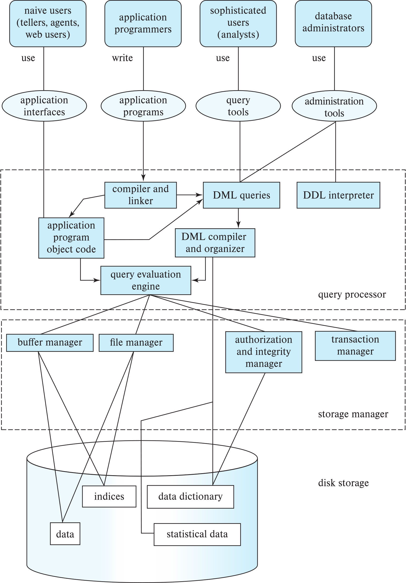
Database Architecture (Centralized/Shared-Memory)

Slide 11
Database Applications
Database applications are usually partitioned into two or three parts
Two-tier architecture -- the application resides at the client machine, where it invokes database system functionality at the server machine
Three-tier architecture -- the client machine acts as a front end and does not contain any direct database calls.
The client end communicates with an application server, usually through a forms interface.
The application server in turn communicates with a database system to access data.

Slide 12
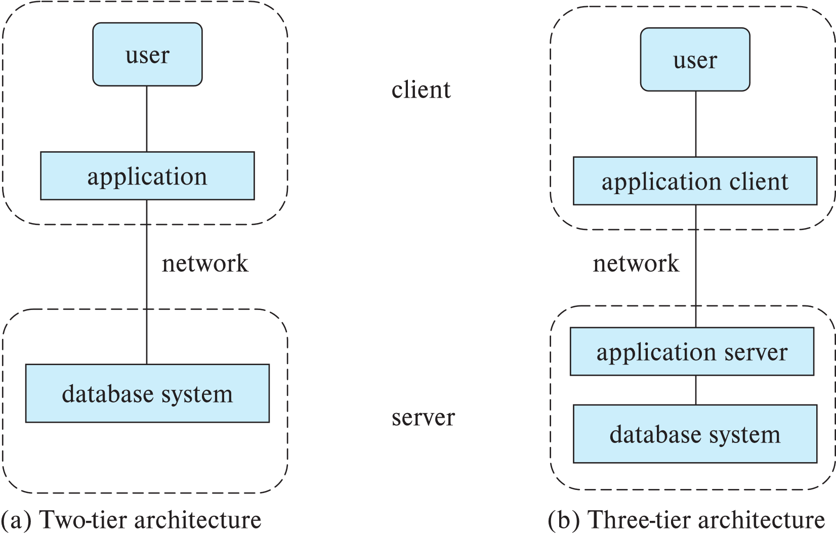
Two-tier and three-tier architectures

Slide 13
Database Users

Slide 14
Database Administrator
Schema definition
Storage structure and access-method definition
Schema and physical-organization modification
Granting of authorization for data access
Routine maintenance
Periodically backing up the database
Ensuring that enough free disk space is available for normal operations, and upgrading disk space as required
Monitoring jobs running on the database

Slide 15
History of Database Systems
1950s and early 1960s:
Data processing using magnetic tapes for storage
Tapes provided only sequential access
Punched cards for input
Late 1960s and 1970s:
Hard disks allowed direct access to data
Network and hierarchical data models in widespread use
Ted Codd defines the relational data model
Would win the ACM Turing Award for this work
IBM Research begins System R prototype
UC Berkeley (Michael Stonebraker) begins Ingres prototype
Oracle releases first commercial relational database
High-performance (for the era) transaction processing

Slide 16
History of Database Systems (Cont.)
1980s:
Research relational prototypes evolve into commercial systems
SQL becomes industrial standard
Parallel and distributed database systems
Wisconsin, IBM, Teradata
Object-oriented database systems
1990s:
Large decision support and data-mining applications
Large multi-terabyte data warehouses
Emergence of Web commerce

Slide 17
History of Database Systems (Cont.)
2000s:
Big data storage systems
Google BigTable, Yahoo PNuts, Amazon,
“NoSQL” systems.
Big data analysis: beyond SQL
Map reduce and friends
2010s:
SQL reloaded
SQL front end to Map Reduce systems
Massively parallel database systems
Multi-core main-memory databases

Slide 18
End of Chapter 1

